Slide 1
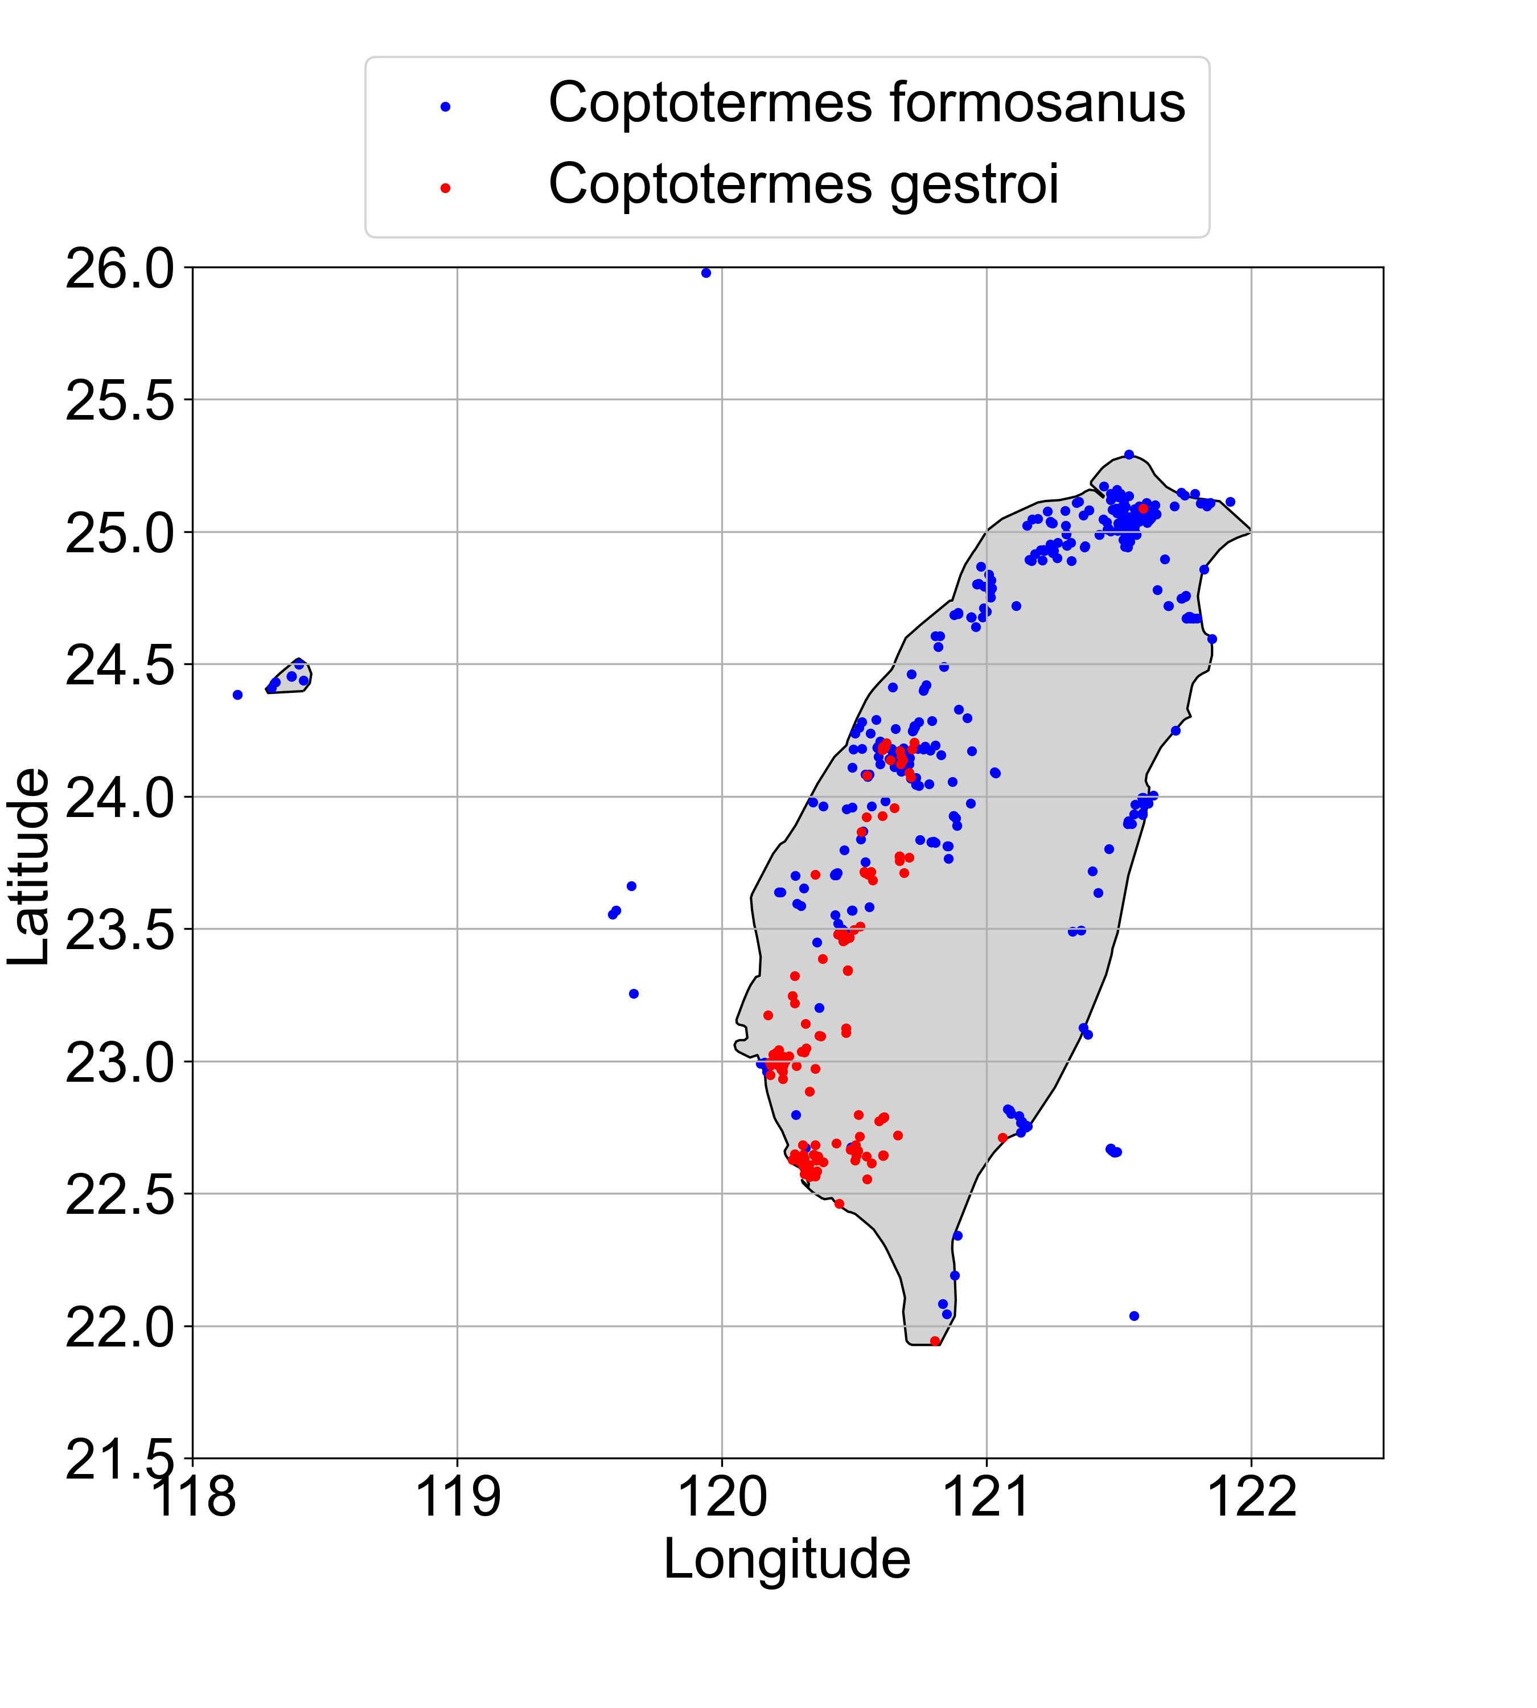
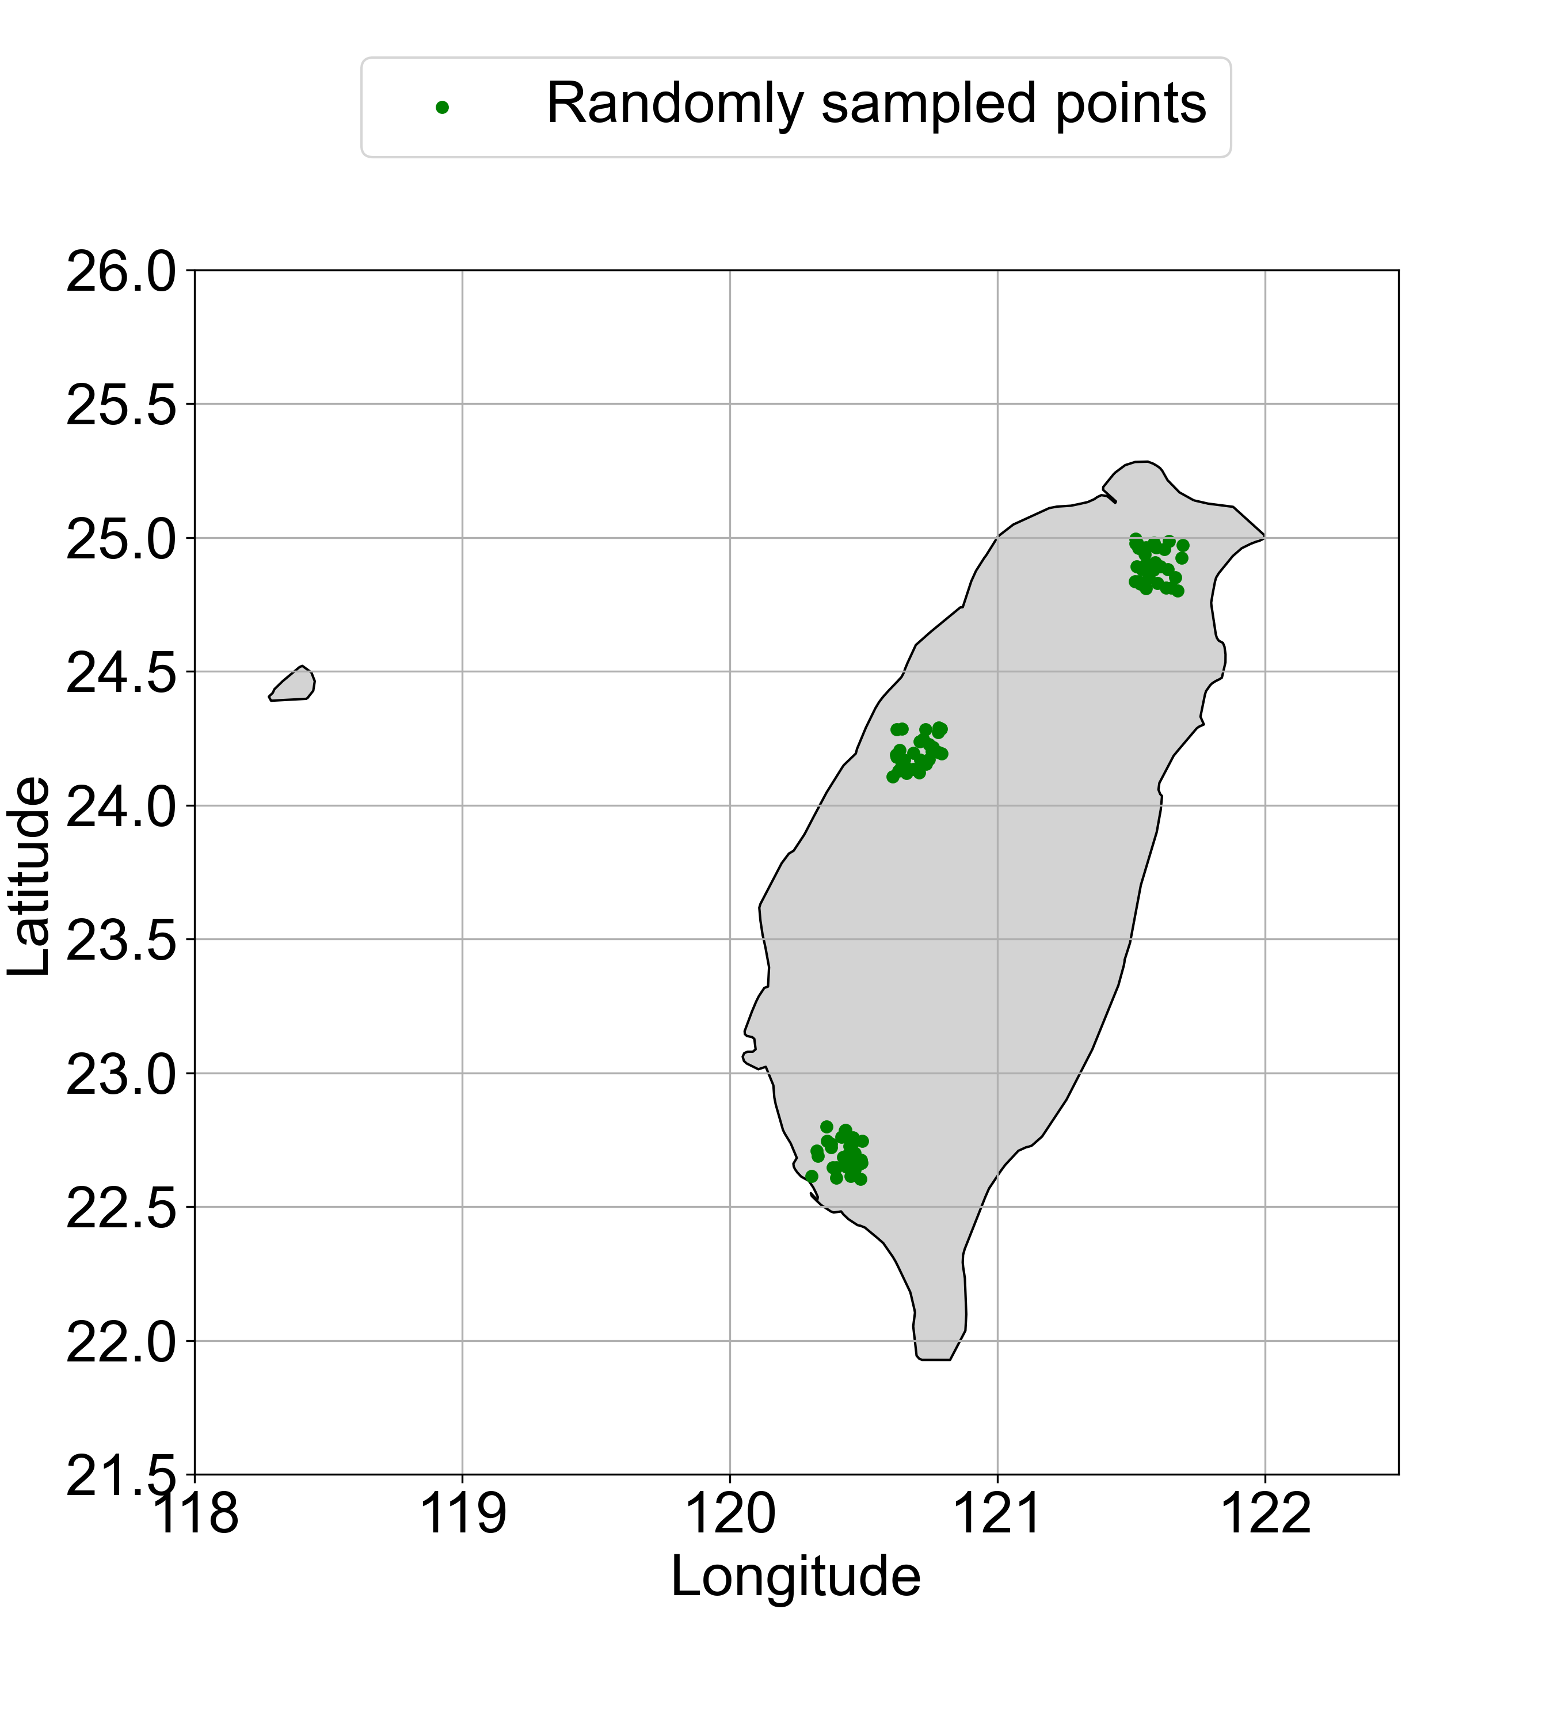
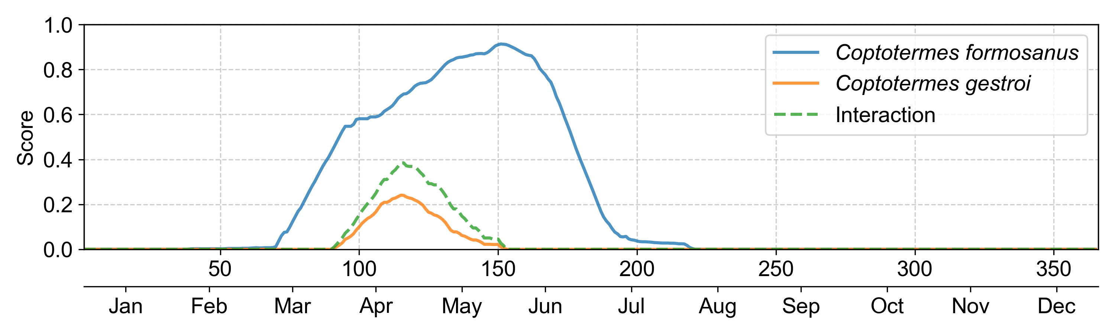
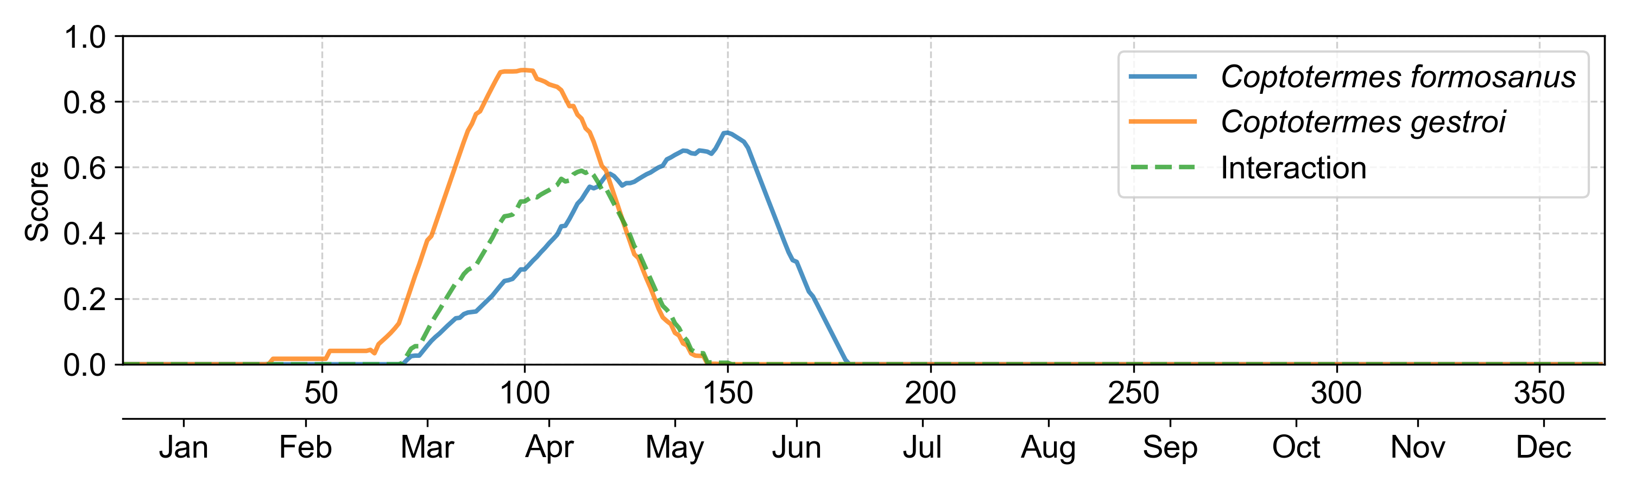
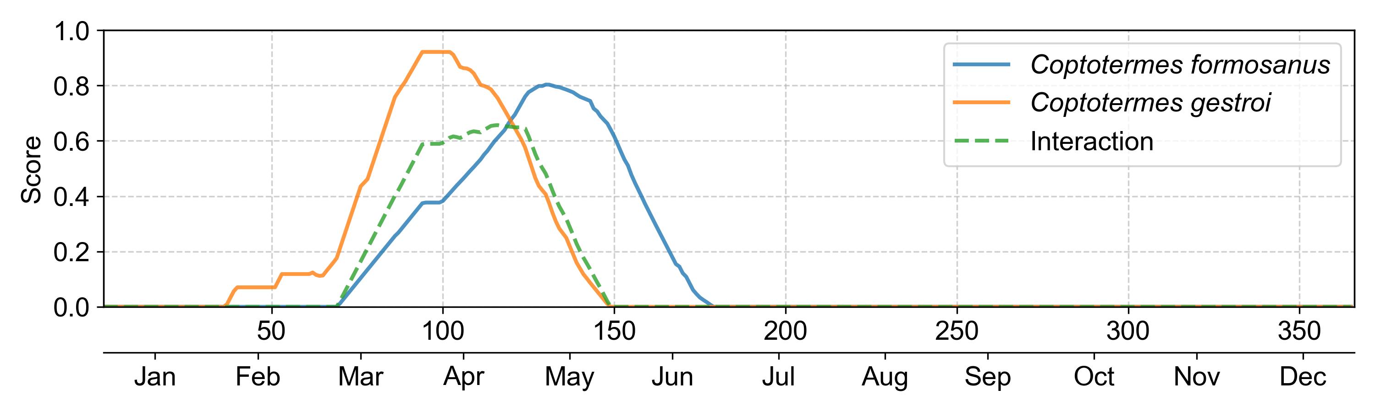
A
B
Northern
Middle-western
Southern
C
Northern
Accumulated
interaction score = 12.2547
D
Middle-western
Accumulated
interaction score = 24.9325
E
Southern
Accumulated
interaction score = 33.7606

